Slide 1

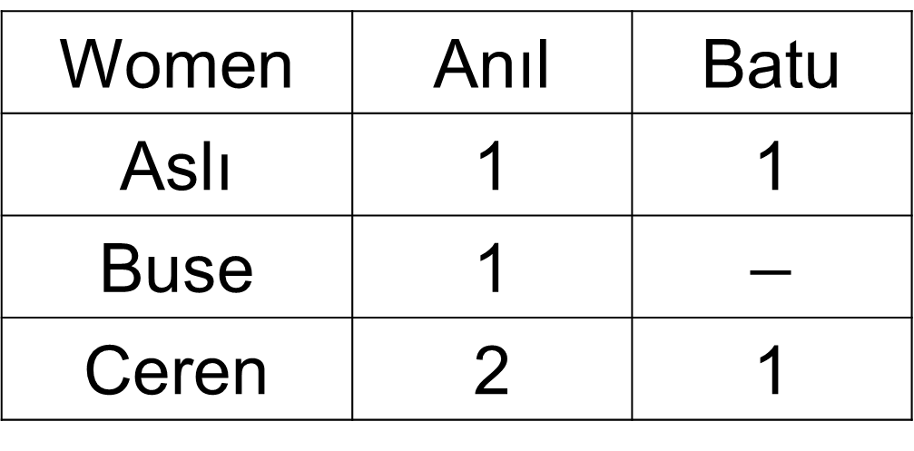
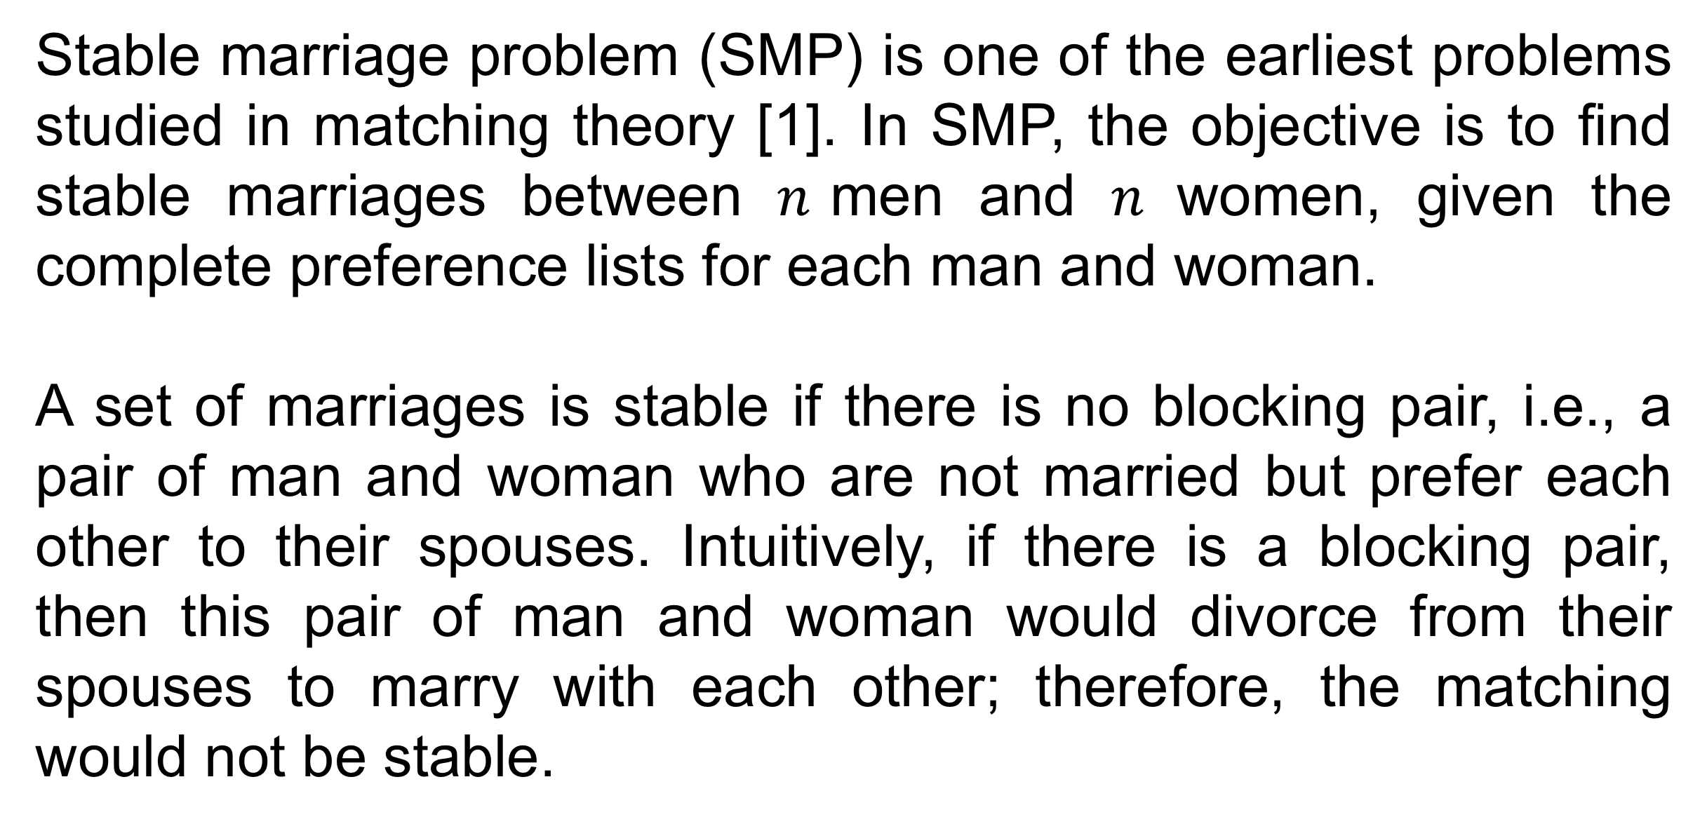
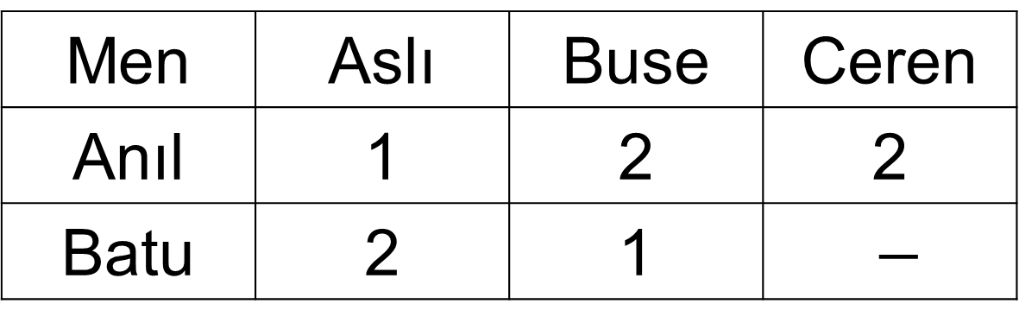
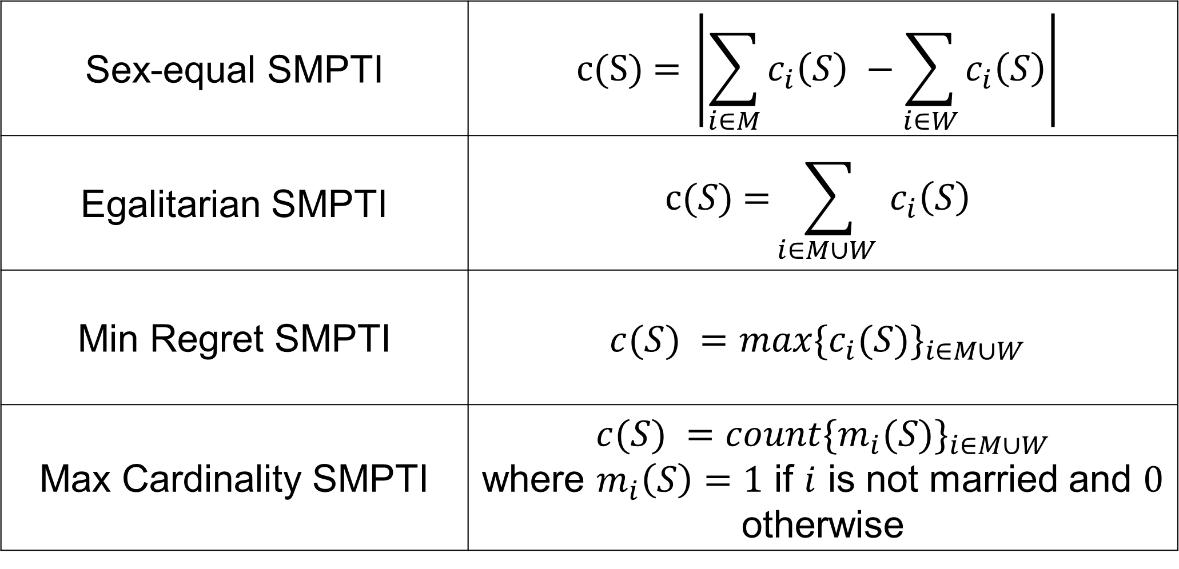
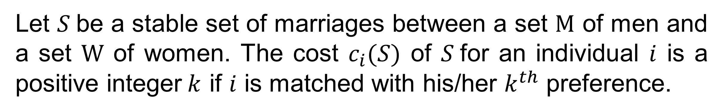
Solving Stable Marriage Problems using Answer Set Programming
Berkan Teber and Selin Eyüpoğlu
Supervised by Ahmet Alkan and Esra Erdem
Stable Marriage Problem (SMP)
Experimental Evaluations
Stable marriage problem (SMP) is one of the earliest problems studied in matching theory [1]. In SMP, the objective is to find stable marriages between $n$men and $n$women, given the complete preference lists for each man and woman.
A set of marriages is stable if there is no blocking pair, i.e., a pair of man and woman who are not married but prefer each other to their spouses. Intuitively, if there is a blocking pair, then this pair of man and woman would divorce from their spouses to marry with each other; therefore, the matching would not be stable.
We have evaluated our ASP formulation empirically on some benchmarks [4]. Experiments are performed on a Linux server with 16 2.4GHz Intel E5-2665 CPU cores and 64GB memory, using the ASP solver CLINGO 4.5.4.
Completeness (%) |  | Ties (%) |  | SexEqual | Egalitarian | MinRegret | MaxCardinality | SMPTI
Men | Women | Men | Women | (sec.) | (sec.) | (sec.) | (sec.) | (sec.)
25 | 25 | 0 | 0 | 0.01 | 0.02 | 0.00 | 0.00 | 0.00
25 | 25 | 0 | 10 | 0.02 | 0.04 | 0.00 | 0.01 | 0.01
25 | 25 | 0 | 20 | 0.01 | 0.02 | 0.00 | 0.00 | 0.01
25 | 25 | 10 | 10 | 0.01 | 0.02 | 0.00 | 0.01 | 0.01
25 | 25 | 10 | 20 | 0.01 | 0.04 | 0.01 | 0.00 | 0.00
25 | 25 | 20 | 20 | 0.02 | 0.03 | 0.00 | 0.01 | 0.01
25 | 50 | 0 | 0 | 0.03 | 0.11 | 0.01 | 0.01 | 0.00
25 | 50 | 0 | 10 | 0.05 | 0.16 | 0.01 | 0.02 | 0.01
25 | 50 | 0 | 20 | 0.02 | 0.11 | 0.01 | 0.01 | 0.00
25 | 50 | 10 | 10 | 0.04 | 0.08 | 0.00 | 0.01 | 0.01
25 | 50 | 10 | 20 | 0.02 | 0.10 | 0.01 | 0.01 | 0.01
25 | 50 | 20 | 20 | 0.05 | 0.20 | 0.01 | 0.01 | 0.02
25 | 100 | 0 | 0 | 0.12 | 0.58 | 0.02 | 0.02 | 0.02
25 | 100 | 0 | 10 | 0.39 | 0.67 | 0.02 | 0.02 | 0.02
25 | 100 | 0 | 20 | 0.28 | 0.86 | 0.02 | 0.01 | 0.01
25 | 100 | 10 | 10 | 0.11 | 0.43 | 0.02 | 0.02 | 0.03
25 | 100 | 10 | 20 | 0.13 | 0.57 | 0.02 | 0.01 | 0.02
25 | 100 | 20 | 20 | 0.14 | 0.86 | 0.02 | 0.02 | 0.01
50 | 50 | 0 | 0 | 0.12 | 0.48 | 0.01 | 0.02 | 0.01
50 | 50 | 0 | 10 | 0.25 | 1.39 | 0.02 | 0.02 | 0.02
50 | 50 | 0 | 20 | 0.14 | 0.55 | 0.01 | 0.02 | 0.01
50 | 50 | 10 | 10 | 0.10 | 0.41 | 0.02 | 0.02 | 0.01
50 | 50 | 10 | 20 | 0.30 | 1.20 | 0.02 | 0.01 | 0.02
50 | 50 | 20 | 20 | 0.68 | 1.35 | 0.02 | 0.02 | 0.01
50 | 100 | 0 | 0 | 5.40 | 6.81 | 0.03 | 0.04 | 0.03
50 | 100 | 0 | 10 | 1.49 | 8.41 | 0.04 | 0.04 | 0.04
50 | 100 | 0 | 20 | 0.83 | 8.53 | 0.03 | 0.02 | 0.04
50 | 100 | 10 | 10 | 2.83 | 4.19 | 0.02 | 0.03 | 0.04
50 | 100 | 10 | 20 | 1.56 | 12.02 | 0.03 | 0.03 | 0.03
50 | 100 | 20 | 20 | 10.69 | 13.99 | 0.04 | 0.04 | 0.04
100 | 100 | 0 | 0 | 1.81 | 55.06 | 0.11 | 0.10 | 0.11
100 | 100 | 0 | 10 | 24.95 | 40.20 | 0.12 | 0.10 | 0.11
100 | 100 | 0 | 20 | 86.50 | 54.76 | 0.13 | 0.11 | 0.11
100 | 100 | 10 | 10 | 23.340 | 90.57 | 0.11 | 0.11 | 0.11
100 | 100 | 10 | 20 | 74.04 | 49.75 | 0.11 | 0.11 | 0.10
100 | 100 | 20 | 20 | 39.99 | 76.78 | 0.11 | 0.13 | 0.10
SMP with Unacceptability and Ties (SMPTI)
Stable marriage problem with unacceptability and ties (SMPTI) is a variant of SMP, where
there can be different numbers of men, and
the preferences of men and women do not have to be complete and may include ties.
As a result, in SMPTI, some men and women may be single.
In SMPTI, a pair of man and woman is a blocking pair if they are not married and each of them is either single and finds the other one acceptable, or married and prefers the other one to his/her actual partner.
We have modeled SMPTI in Answer Set Programming (ASP) [2] and used the ASP solver CLINGO [3] to compute solutions.
Men | Aslı | Buse | Ceren
Anıl | 1 | 2 | 2
Batu | 2 | 1 | $−$
Women | Anıl | Batu
Aslı | 1 | 1
Buse | 1 | $$−$$
Ceren | 2 | 1
In each instance, input size is 20 men and 20 women.
In the experimental results, we have seen that minimum regret SMPTI and maximum cardinality SMPTI take similar amount of time, and sex-equal SMPTI and egalitarian SMPTI take similar amount of time, due to the similarities of the representations of their cost functions.
We have also seen that sex-equal SMPTI and egalitarian SMPTI take much longer computation times as the percentage of completeness and the percentage of ties increase, due to large sizes of summations used in weak constraints.
Solution 1 | {(Anıl, Ceren), (Batu, Aslı)}
Solution 2 | {(Anıl, Buse), (Batu, Aslı)}
Solution 3 | {(Anıl, Aslı)}
Optimization Variants
Let $S$be a stable set of marriages between a set M of men and a set W of women. The cost $c_{i}(S)$ of $S$for an individual $i$ is a positive integer$k$ if $i$ is matched with his/her $k^{th}$ preference.
Sex-equal SMPTI | $$c\text{(}\text{S}\text{) = }\left|\sum_{i∈M}{c_{i}\left(S\right)} −\sum_{i∈W}{c_{i}\left(S\right)}\right|$$
Egalitarian SMPTI | $$c(S)\text{ =}\sum_{i∈M∪W }{c_{i}\left(S\right)}$$
Min Regret SMPTI | $$c(S) =max⁡{\{c_{i}(S)\}}_{i∈M∪W}$$
Max Cardinality SMPTI | $$c(S) =count⁡{\{m_{i}(S)\}}_{i∈M∪W}$$ where $m_{i}\left(S\right)=1$ if $i$ is not married and $0$ otherwise
References
Gale, D., & Shapley, L. (1962). College Admissions and the Stability of Marriage. The American Mathematical Monthly, 69(1), 9-15.
Gelfond, M., & Lifschitz, V. (1988). The stable model semantics for logic programming. In Proc. of ICLP.
Gebser, M., Kaminski, R., Kaufmann, B., & Schaub, T. (2014). Clingo = ASP + Control: Preliminary Report. In Proc. of ICLP.
S. Eyupoglu, B. Teber, A. Alkan, & E. Erdem. (2018, under review). Knowledge-Rich Stable Marriage Problems.
To solve each variant, we have extended our ASP model with a relevant optimization statement.

